Slide 1
A Comparison of Consensus Algorithms in Blockchain SDN Architectures
Joshua Sylvester, Sunjoli Aggarwal, Rob Keehan,
Michael Watts, & Matthew Lee
Notes:
Sunjoli
Introduce our names and title of our project:
We present an evaluation of consensus algorithms in blockchain architectures, focused on an application domain of Software Defined Networks.

Slide 2
Overview
Solution
Background
Problem
Conclusions
Analysis &
Notes:
Sunjoli
Think of this like our abstract: Say the overview but actually define each thing we’re about to talk about
In background, e will go over Software Defined Networks, which is the application domain that inspired this research problem, and over the basics of Blockchain Networks, demonstrating how Blockchains can help solve some of the issues in SDNs
Our problem is an optimization problem, specifically about optimizing how a blockchain network reaches consensus
In solution we explain how we approached simulating a blockchain network
In analysis & conclusion we analyze the results numerically and will

Slide 3
1.
Solution
Background
Problem
Conclusions
Analysis &
Notes:
Sunjoli
We begin with a background of the relevant technologies

Slide 4

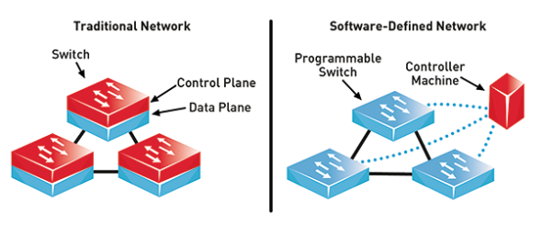
SDN
Notes:
Matthew
Centralize control plane into one controller
Globally optimized routing

Slide 5
SDN
Globally optimized routing
One logical controller for a network
Issues
Centralization
Synchronization
Notes:
Matthew
Allows for programmable routing and easier maintenance.
Adaptation to global flow patterns
In theory, one controller. In practice, need multiple controllers acting together
Each physical controller directly controls subset of nodes
Synchronization without compromising security
Solution: blockchain

Slide 6
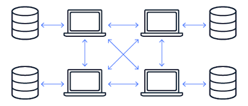
Blockchain
A distributed ledger where network agrees on transactions
Notes:
Josh
Blockchain gained popularity initially with the release of Bitcoin, a cryptocurrency in 2009 [8]. Today, blockchain remains one of the primary data structures utilized in the cryptocurrency landscape. However, the terms blockchain and cryptocurrency should not be confused for being one and the same. Blockchain technology is the implementation of an immutable distributed database, also known as a ledger. Transactions, or changes to the ledger, can occur and must be documented in the ledger. Nodes across a network keep copies of this ledger and append new blocks of transactions to it [27, Fig. 2].

Slide 7

Blockchain
Notes:
Josh
The nodes will agree upon which new blocks are to be treated as a part of the blockchain through a process which is called consensus [5].
The architecture of the blockchain, with its decentralized maintenance of information, provides an alternative to this single point of failure [15]. By maintaining a history of transactions through the ledger, blockchain also makes it easier to identify potential malicious or fake routing information injected into a compromised SDN [15].

Slide 8
2.
Solution
Background
Problem
Conclusions
Analysis &
Notes:
Now we will go over the problem motivation and how we got to our specific problem statement

Slide 9

Problem Motivation
SDN centralization & synchronization issues
Blockchain as a solution
PoW is the predominant consensus algo used
?
Notes:
Sunjoli
As Matthew mentioned earlier, an SDN is actually
As we mentioned earlier, blockchain’s distributed nature provides a solution to the vulnerable centralization of SDNs, and the concept of consensus in blockchain provides a solution to the issue of physical SDN controller synchronization
We set out to look at current work involving blockchain SDN architectures, and we started to noice that a couple of them will default to using the same consensus algorithm, Proof Of Work, with very little explanation as to why they chose that one in particular
We wanted to challenge this assumption and find the best way to achieve consensus

Slide 10
We explore a consensus optimization problem where time and scale are constrained by the application domain of SDN blockchain architectures
Notes:
Sunjoli
Thus, we arrived at this particular problem statement. We explore a consensus optimization problem where time and scale are constrained by the application domain of SDN blockchain architectures.
Transition: So how did we do this?

Slide 11
3.
Solution
Background
Problem
Conclusions
Analysis &
Notes:
Sunjoli
We approached this optimization problem by computationally simulating blockchain networks of varying scale at 11, 33, 101, and 301 nodes with three different consensus algorithms: Proof of Work, Practical Byzantine Fault Tolerance, and Proof of Elapsed Time. Our main metric was to look at how long the blockchain network took to reach consensus.

Slide 12

PoW
Notes:
Explain PoW
Michael & Rob
Forking - when two nodes in a network create a block at the same time, these blocks will be conflicting and likely included similar transactions.
This is fixed by the nodes in the network mining towards the block that they receive first. This basically splits the network creating a race between the forked chains. When one chain mines a block and becomes longer the nodes will switch to mining for that chain. This will achieves consensus

Slide 13
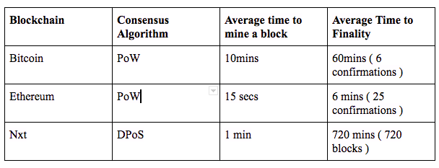
Forking in PoW
Notes:
Explain PoW
Michael & Rob
Forking - when two nodes in a network create a block at the same time, these blocks will be conflicting and likely included similar transactions. This is fixed by the nodes in the network mining towards the block that they receive first. This basically splits the network creating a race between the forked chains. When one chain mines a block and becomes longer the nodes will switch to mining for that chain. This will eventually achieve consensus among all the nodes as more nodes mine for one side of the fork. As you can see in the chart above bitcoin and ethereum use long block times to avoid forks. The block needs to have a certain number of blocks in front of it for it to be statically improbable for it to ever be reverted because of a fork. Also, with longer block times you are less likely to have two blocks conflict, but then you have a slower network. We have not fully implemented forking in our PoW algorithm, but we plan to add it because it is the largest trade off of PoW.

Slide 14

pBFT
Notes:
Matthew
Explain pBFT
Depends on ⅔ of nodes agreeing on a block
Each node must send to all other nodes to ensure consensus
As long as less than ⅓ of the nodes are faulty or malicious, all loyal nodes reach same conclusion
For n nodes, need n^2 communications per block, communication latency
Limited scalability

Slide 15

PoET
Notes:
Josh
Explain pOET

Slide 16
Results
Average times for a block to reach consensus (s)
 | PoW *no forking | PoET | pBFT
11 Nodes | 0.256 | 0.248 | 1.065
33 Nodes | 0.415 | 0.375 | 3.631
101 Nodes | 0.601 | 0.53 | 22.107
301 Nodes | -- | 0.658 | 226.49
Notes:
Josh
These were the results we got- don’t go into too much detail

Slide 17
4.
Solution
Background
Problem
Conclusions
Analysis &
Notes:
Josh

Slide 18
Analysis
Analysis of Time to Achieve Consensus
 | PoW *no forking | PoET | pBFT
11 Nodes | low | low | medium
33 Nodes | low | low | medium
101 Nodes | low | low | high
301 Nodes | -- | low | extremely high
Notes:
Josh

Slide 19
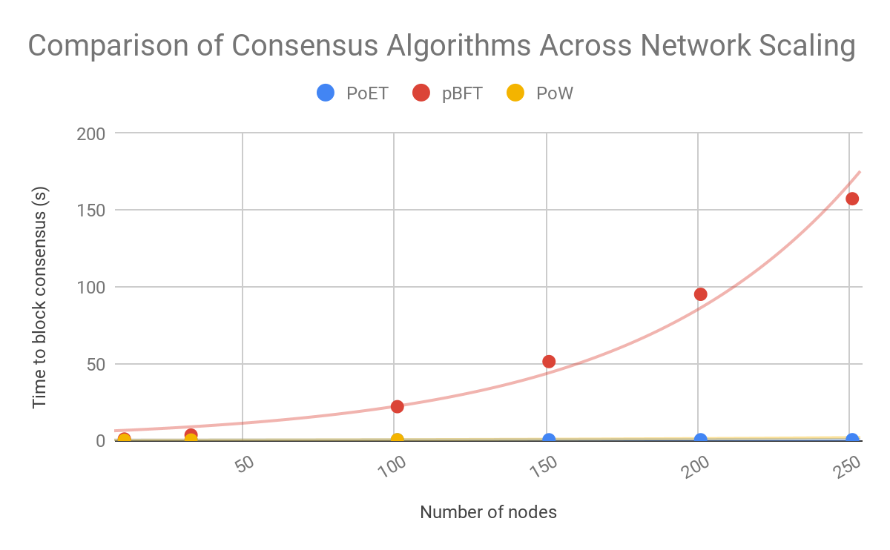
Analysis
Notes:
Josh

Slide 20
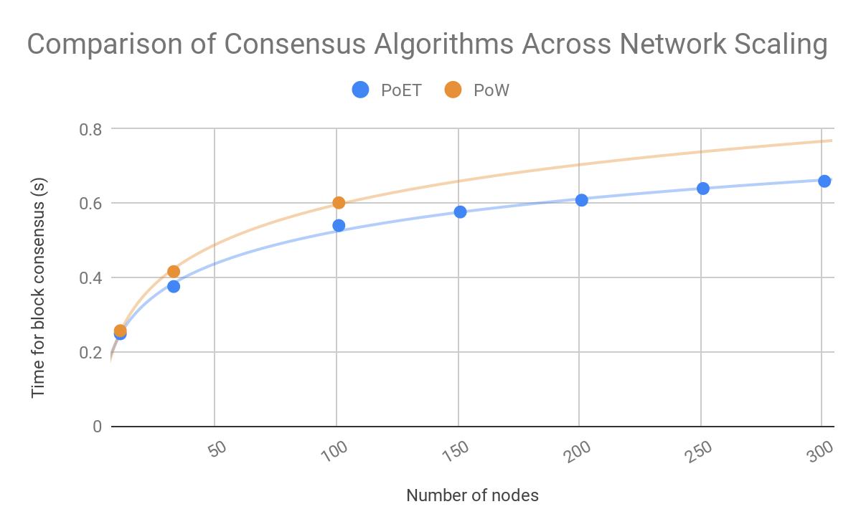
Analysis
Notes:
Rob - Without forking, PoET and PoW are almost the same. Work is based off of hashing and guessing a hash while eslaped time is generating a random number and waiting. PoET gets rid of forking by having a timestamp on blocks because the algorithm is made for private systems. PoW needs to be able to handle forking because it is used with public systems.

Slide 21
Conclusions
Notes:
Michael
In our analysis of our results we defined what consensus algorithms were optimal within the context of different sized blockchain networks, but discussion of which size/scale of network itself is optimal is not possible without an application domain.
In the SDN architecture context, we can take a fresh look at Practical Byzantine Fault Tolerance's need to communicate with every node in the network and realize that it would be most practical to implement this with the use of a backplane. However, it is important not to ignore the overhead that comes along with implementing such a backplane for communication.
This backplane communication, however, aligns with an example use case of a data center. In data centers, there are direct communication links between physical SDN controllers which makes pBFT the optimal consensus algorithm to implement, since each node can efficiently send its vote to all other nodes.
In other use-cases, such as an IOT network or an ISP network, perhaps a combination of two consensus algorithms may be necessary as a trade-off to actually implement. We will explore this idea further once we have concrete results to analyze.

Slide 22

Conclusions
 | Pros | Cons
pBFT | High Performance in Low Node Networks | Scalability
PoET | Highly Scalable | Hardware Constraint
PoW | Public Setting | Computationally Intensive
Notes:
Consider case of implementation in SDN constratined domain
Poet requires very specific hardware; the other two don’t have these kinds of constraints
pBFT needs a way to rapidly communicate with other nodes, better for data center
PoW ftw
pBFT does better with low nodes
P

Slide 23
Overview
Solution
Background
Problem
Conclusions
Analysis &
Notes:
Sunjoli
Think of this like our abstract: Say the overview but actually define each thing we’re about to talk about
In background, e will go over Software Defined Networks, which is the application domain that inspired this research problem, and over the basics of Blockchain Networks, demonstrating how Blockchains can help solve some of the issues in SDNs
Our problem is an optimization problem, specifically about optimizing how a blockchain network reaches consensus
In solution we explain how we approached simulating a blockchain network
In analysis & conclusion we analyze the results numerically and will

Slide 24
Questions

